Slide 1
Clustering

Slide 2
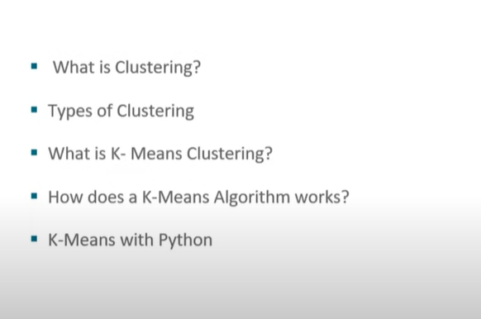



Agenda

Slide 3
Introduction
Clustering is an unsupervised method of data analysis.
Data with no target attribute.
Describe hidden structure from unlabeled data.
attempts to find groups or clusters of observations within a dataset.
Why is it unsupervised?
Because it does not rely on predefined classes or trained data. It is learning by observation, not learning by examples.

Slide 4
Goal of Clustering
The goal is to find clusters such that the observations within each cluster are quite similar to each other, while observations in different clusters are quite different from each other.

Slide 5
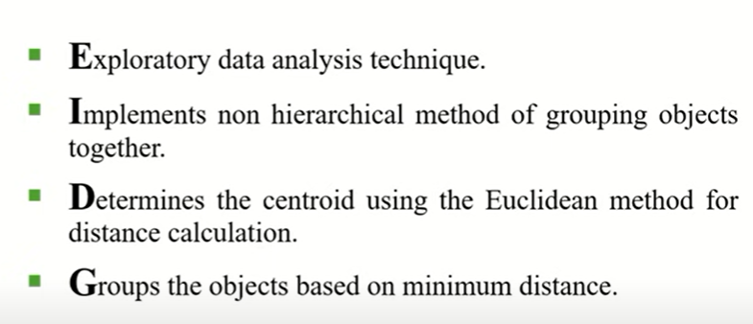
Introduction

Slide 6
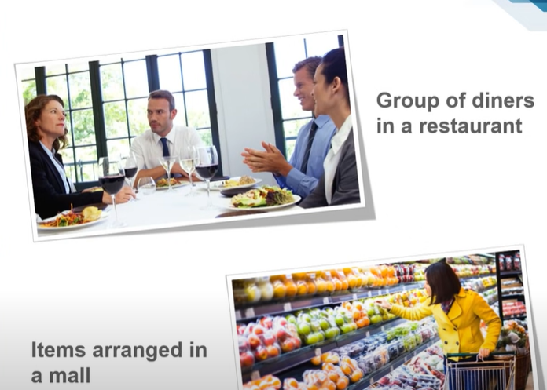

Slide 7

Applications

Slide 8
Types of Clustering
Clustering is a type of unsupervised learning wherein data points are grouped into different sets based on their degree of similarity.
The various types of clustering are:
Hierarchical clustering
Partitioning clustering
Hierarchical clustering is further subdivided into:
Agglomerative clustering
Divisive clustering
Partitioning clustering is further subdivided into:
K-Means clustering
Fuzzy C-Means clustering

Slide 9
/
Distance Measure
Distance measure determines the similarity between two elements and influences the shape of clusters.
K-Means clustering supports various kinds of distance measures, such as:
Euclidean distance measure
Manhattan distance measure
A squared euclidean distance measure
Cosine distance measure

Slide 10
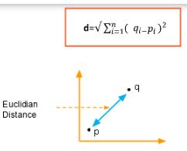

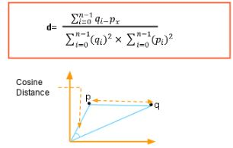
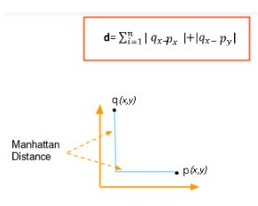

Slide 11
Algorithm
Randomly choose k data points (Seeds) to be the initial cluster centres.
Assign each data point to the closest cluster centre.
Re-compute the cluster centers using the current cluster memberships.
If a convergence criterion is not met go to step 2.

Slide 12
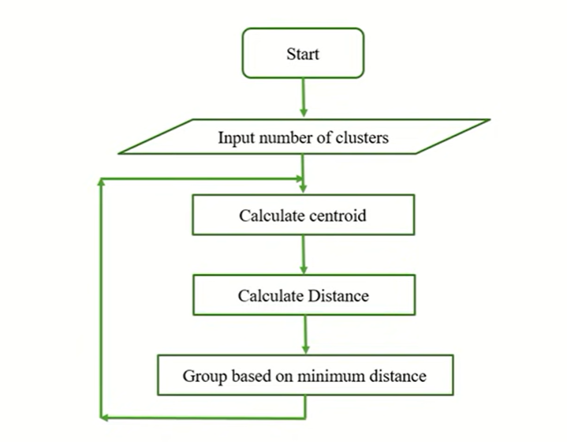
How Does K-Means Clustering Work?

Slide 13
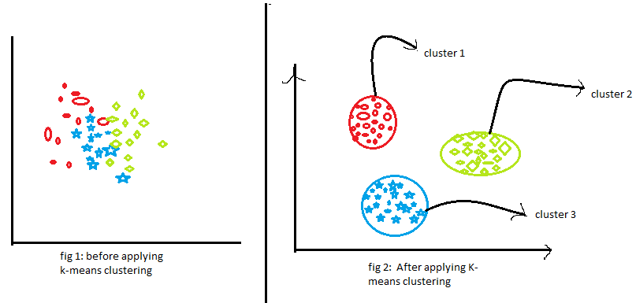
K-Means Clustering-
K-Means clustering is an unsupervised iterative clustering technique.
It partitions the given data set into k predefined distinct clusters.
A cluster is defined as a collection of data points exhibiting certain similarities.

Slide 14
Applications of K-Means Clustering
K-Means clustering is used in a variety of examples or business cases in real life, like:
Academic performance
Diagnostic systems
Search engines
Wireless sensor networks

Slide 15
Examples
Example: Streaming Services
Streaming services often use clustering analysis to identify viewers who have similar behavior.
For example, a streaming service may collect the following data about individuals:
Minutes watched per day
Total viewing sessions per week
Number of unique shows viewed per month

Slide 16
Worked Example – K means
Suppose we have five objects and each object have two attributes as shown below. Our goal is to group these objects into K=2 group of objects based on the two attributes.
Number of Cluster K=2
 | X | y
1 | 0 | 1
2 | 1 | 3
3 | 3 | 1
4 | 5 | 0
5 | 6 | 0

Slide 17

Step 1: Choose random k points and set as cluster centers
C1 = ( 0,1) C2=(3,1)
Step 2: Calculating the distance between objects into cluster centroids by using Euclidean distance
D _{i, j}=$\sqrt{{\left(x1−x2\right)}^{2}+{\left(y1−y2\right)}^{2}}$

Slide 18

d1 = {(0, 1), (0, 1)} 1. d2 = {(0,1), ( 3,1)}
=$\sqrt{{\left(0−0\right)}^{2}+{\left(1−1\right)}^{2}}$ =$\sqrt{{\left(0−3\right)}^{2}+{\left(1−1\right)}^{2}}$
=0 = 3
d1 = {(1, 3), (0, 1)} 2. d2 = {(1,3), ( 3,1)}
=$\sqrt{{\left(1−0\right)}^{2}+{\left(3−1\right)}^{2}}$ =$\sqrt{{\left(1−3\right)}^{2}+{\left(3−1\right)}^{2}}$
=2.2 = 2.82
d1 = {(3,1), ( 0,1)} 3. d2 = {(3,1), ( 3,1)}
=$\sqrt{{\left(3−0\right)}^{2}+{\left(1−1\right)}^{2}}$ =$\sqrt{{\left(3−3\right)}^{2}+{\left(1−1\right)}^{2}}$
=3 = 0
d1 = {(5,0), ( 0,1)} 4. d2 = {(5,0), ( 3,1)}
=$\sqrt{{\left(5−0\right)}^{2}+{\left(0−1\right)}^{2}}$ =$\sqrt{{\left(5−3\right)}^{2}+{\left(0−1\right)}^{2}}$
=5.2 = 2.2

Slide 19

d1 = {(6,0), ( 0,1)} d2 = {(6,0), ( 3,1)}
=$\sqrt{{\left(6−0\right)}^{2}+{\left(0−1\right)}^{2}}$ =$\sqrt{{\left(6−3\right)}^{2}+{\left(0−1\right)}^{2}}$
=6.1 = 3.3
C1 = {(0, 1), (1, 3)}
C2 = {(3, 1), (5, 0), (6, 0)}
 | X | y
1 | 0 | 3
2 | 2.2 | 2.82
3 | 3 | 0
4 | 5 | 2
5 | 6.08 | 3.16

Slide 20
 | (0,1) (Cluster 1) | (3,1) (Cluster 2)
1 | 0 | 3
2 | 2.2 | 2.82
3 | 3 | 0
4 | 5 | 2
5 | 6.08 | 3.16
 | X | Y | Cluster
1 | 0 | 1 | C1
2 | 1 | 3 | C1
3 | 3 | 1 | C2
4 | 5 | 0 | C2
5 | 6 | 0 | C2

Slide 21

Step3: Recalculating the position of the centroid
Compute new centroid
Mean=
C1 =
New C1 = (0.5, 2)
C2 =
New C2 = (4.8, 0.3)
Step 4: Go back to Steps 2 unless the centroids are not changing

Slide 22
Advantages of K-means
It is very simple to implement.
It is scalable to a huge data set and also faster to large datasets.
it adapts the new examples very frequently.
Generalization of clusters for different shapes and sizes.
Disadvantages of K-means
It is sensitive to the outliers.
Choosing the k values manually is a tough job.
As the number of dimensions increases its scalability decreases.

Slide 23
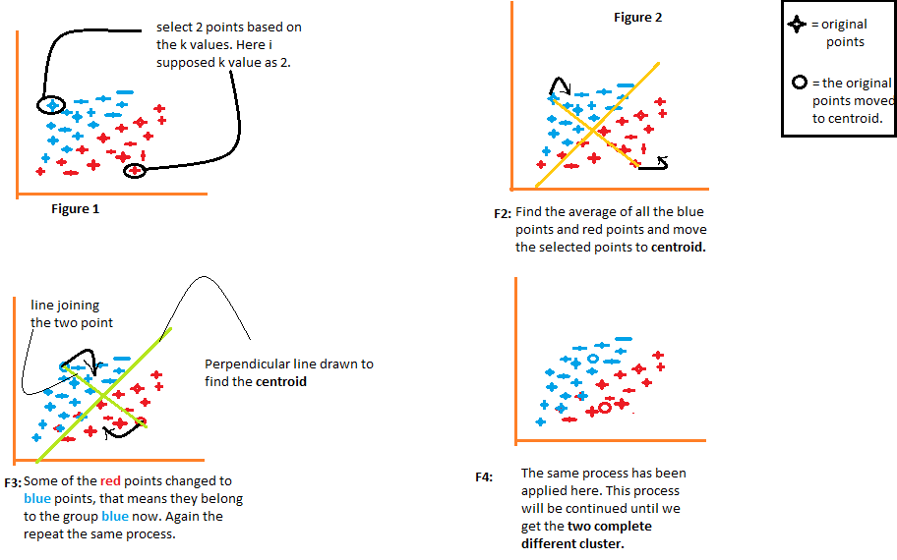

Slide 24
Drawback of k-mean
Sensitive to initial seeds
Sensitive to outlier because an object with an “extremely large value”.

Slide 25
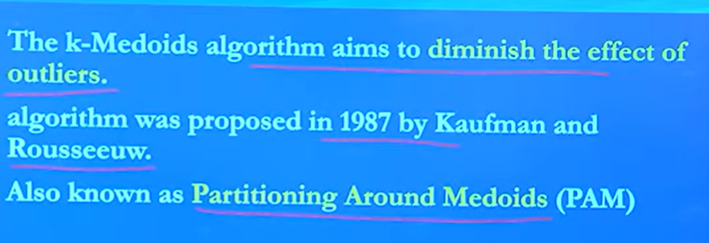
K-mediods

Slide 26
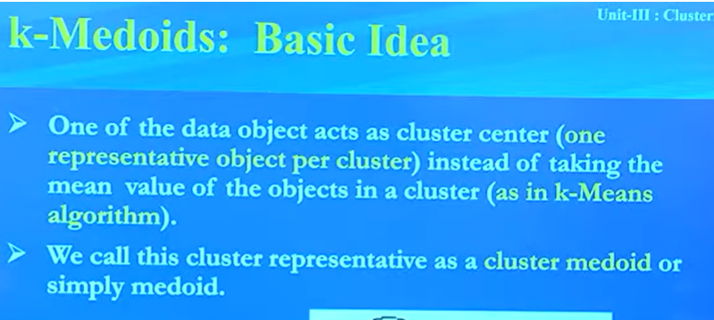

Slide 27
K-medoid Algorithm
Initialize: Select k random points out of the n data points as the medoids
Associate each data point to the closest medoid by using any common distance measure.
While the cost decreases:
For each medoid m for each data o point which is not a medoid.
Swap m and o, associate each data point to the closest medoids recompute the cost.
If the total cost is more than that in the previous step, undo the step.

Slide 28
https://codinginfinite.com/k-medoids-clustering-algorithm-with-numerical-example/
ADVANTAGES OF K-MEDOIDS CLUSTERING
K-Medoids clustering is a simple iterative algorithm
K-Medoids clustering is guaranteed to converge.
K-Medoids clustering doesn’t apply to a specific domain.
K-Medoids clustering algorithm is very robust and it effectively deals with outliers and noise in the dataset.

Slide 29
DISADVANTAGES OF K-MEDOIDS CLUSTERING
K-Medoids clustering is not a scalable algorithm.
In K-Medoids clustering, we don’t know the optimal number of clusters.
K-Medoids clustering algorithm chooses the initial medoids in a random manner.

